Slide 1
Good practices on collection, management and use of site monitoring data in Rwanda
Presenter: EPIMAUQE TUYISENGE

Slide 2
Outline
Data collection process
Data use to identify gaps hindering accreditation
Lessons learnt

Slide 3
Site monitoring data collection
Data collection tools
  SPI-RT checklist for site audit
  Integrated CQI tool
  Electronic proficiency testing (ePT) data on PT
Data collection process
  Who: National Reference Laboratory and site Q-corps
  Frequency:
    Site Audit: Annually; case by case basis
    Proficiency testing: Once every year
    CQI: Once every year; case by case basis

Slide 4
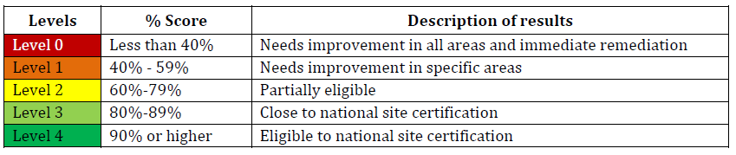
SPI-RT checklist for site audit
Used to collect aggregate data on site performance across seven sections that align with standard requirement specific for HIV rapid testing
Electronic version, easy for use. Audit data uploaded on NRL server
Pre-audit, Audit and post audit sessions needed
Consists of five different levels (L0 to L5) to indicate status toward national certification
Auditors complete a “summary of audit findings” form to evaluate testing points operations per SPI-RT checklist items listing issues/gaps observed and recommendations

Slide 5
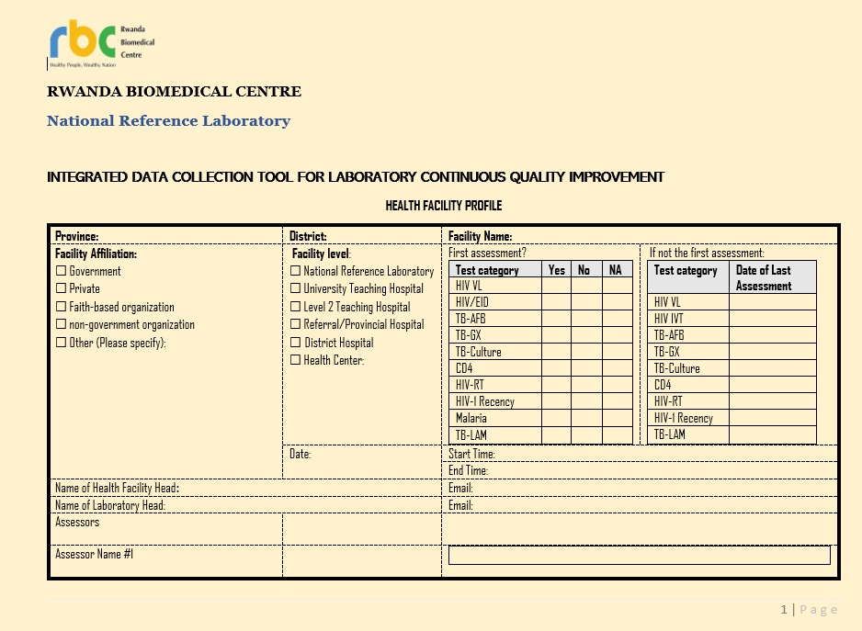
Integrated CQI tool
Used to collect aggregate data on quality of testing of HIV/VL/ EID;TB/AFB/Xpert, Culture; CD4, HIV/Recency; Malaria and TB/LAM
Integrated to minimize cost, avoid redundancy, time and promote synergy/coordination in QA
Evaluates status of applicable quality essentials
Electronic version (deployed)
Requires team organization, prior planning and coordination

Slide 6
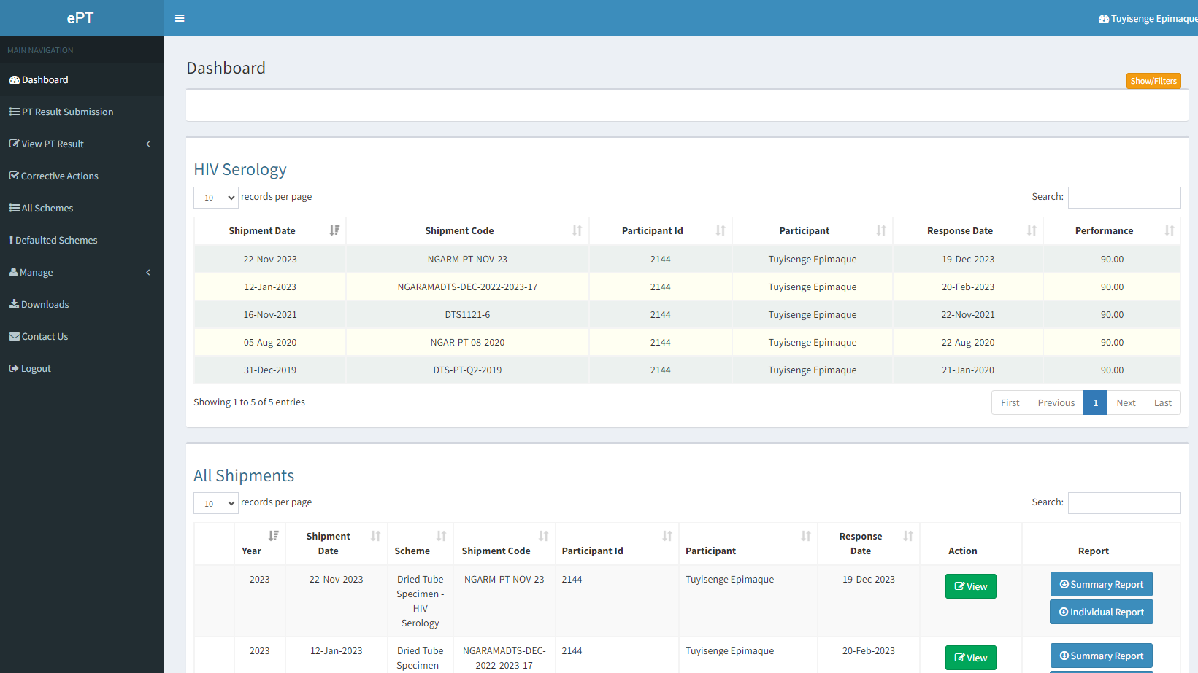
Electronic proficiency testing (ePT) data on PT
Online data tool to capture proficiency testing (PT) data on shipments, tester particulars and scores, and PT provider feedback to testers
Allows PT providers to send electronic shipments of PT panels and allows testers to submit online responses after receiving and testing physical samples
Requires user credentials for data security. Used by all HIV testers in Rwanda.
Generates individual and site PT summary scores per shipment to indicate individual/Site performance to inform corrective action

Slide 7
Proficiency testing data use to monitor PT program coverage and tester performance
PT Program Coverage of Testers
Tester performance

Slide 8
Lessons learnt
Use of electronic tools facilitates data collection, analysis & archiving
Insufficient use of laboratory data use for program planning
Limited skills in data analysis among laboratorians

Slide 9
ACKNOWLEDGEMENTS
US Centers for Disease Control and Prevention (CDC)
Africa Field Epidemiology Network (AFENET)
Rwanda Biomedical Center/ National Reference Laboratory (NRL)
Rwanda Ministry of Health, ICAP and Ngarama DH
PEPFAR

Slide 10


THANK YOU

